Slide 1
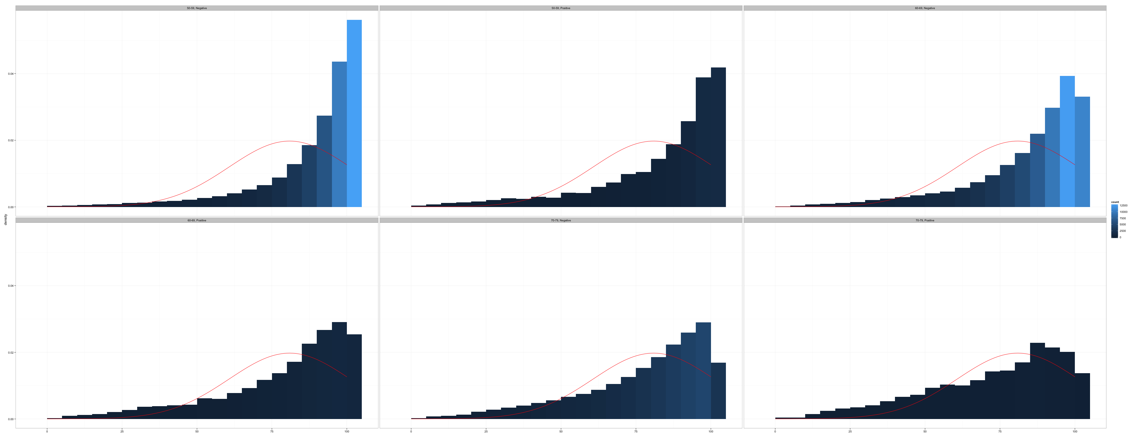
Identifying Skip Patterns
Introduction to Data Management and Statistical Computing

Slide 2
Have you ever been told that you have cancer?
Have you ever been told you have asthma?
In what year were you first told that you have cancer?
In what month were you first told that you have cancer?
Which of the following forms of cancer were you told you have?
Which of the following forms of treatment did you receive for cancer?
cancer_1 | cancer_2 | cancer_3 | cancer_4 | cancer_5
Notes:
Now, let’s think about how these responses will be represented in our data set. For starters, we’ll need a variable to capture the response for each of the cancer questions. Here I’m just naming them cancer_1 through cancer_5. If this were a real survey, you’d likely want more descriptive variable names.

Slide 3
Have you ever been told that you have cancer?
Have you ever been told you have asthma?
In what year were you first told that you have cancer?
In what month were you first told that you have cancer?
Which of the following forms of cancer were you told you have?
Which of the following forms of treatment did you receive for cancer?
cancer_1 | cancer_2 | cancer_3 | cancer_4 | cancer_5
1
Notes:
Let’s say the first participant was told that they have cancer at some point. So, they will have a value of one for the variable cancer_1.

Slide 4
Have you ever been told that you have cancer?
Have you ever been told you have asthma?
In what year were you first told that you have cancer?
In what month were you first told that you have cancer?
Which of the following forms of cancer were you told you have?
Which of the following forms of treatment did you receive for cancer?
cancer_1 | cancer_2 | cancer_3 | cancer_4 | cancer_5
1 | 7 | 2016 | breast | radiation
Notes:
And, because they had cancer, we ask them to rest of the child questions.

Slide 5
cancer_1 | cancer_2 | cancer_3 | cancer_4 | cancer_5
1 | 7 | 2016 | breast | radiation
0
Have you ever been told that you have cancer?
Have you ever been told you have asthma?
In what year were you first told that you have cancer?
In what month were you first told that you have cancer?
Which of the following forms of cancer were you told you have?
Which of the following forms of treatment did you receive for cancer?
Notes:
Our second participant was never told that they had cancer. So, they will have a value of zero for the variable cancer_1. But, what values should we give them for the child questions?

Slide 6
cancer_1 | cancer_2 | cancer_3 | cancer_4 | cancer_5
1 | 7 | 2016 | breast | radiation
0 | . | .
Have you ever been told that you have cancer?
Have you ever been told you have asthma?
In what year were you first told that you have cancer?
In what month were you first told that you have cancer?
Which of the following forms of cancer were you told you have?
Which of the following forms of treatment did you receive for cancer?
Notes:
As you probably guessed, for the second participant the values for the child cancer questions will be missing. We never asked the questions, so missing is the only value that logically makes sense, right?

Slide 7
Have you smoked at least 100 cigarettes in your entire life?
Notes:
Now let’s look at another set of questions. Here, the parent question is “have you smoked at least 100 cigarettes in your entire life.” This question is commonly used to classify a participant as someone who has ever smoked, or not. It may not be entirely intuitive, but if someone has smoked 99 cigarettes in their life, and honestly answers this question, we consider them to be a non-smoker.

Slide 8
Have you smoked at least 100 cigarettes in your entire life?
At what age did you smoke your first cigarette?
During the past 30 days, how many packs of cigarettes a day did you smoke on average?
Notes:
We may also want to follow-up with questions about age at smoking initiation, and number of packs smoked per day.

Slide 9
No
Have you smoked at least 100 cigarettes in your entire life?
Have you ever been told you have asthma?
At what age did you smoke your first cigarette?
During the past 30 days, how many packs of cigarettes a day did you smoke on average?
Notes:
And again, if the participant tells us that they haven’t smoked 100 cigarettes in their life, then we skip over the child questions.

Slide 10
No
smoke_1 | smoke_2 | smoke_3
0 | . | .
Have you smoked at least 100 cigarettes in your entire life?
Have you ever been told you have asthma?
At what age did you smoke your first cigarette?
During the past 30 days, how many packs of cigarettes a day did you smoke on average?
Notes:
And again, the skip pattern will result in missing data in our data set.

Slide 11
id | cancer_1 | cancer_2 | cancer_3 | cancer_4 | cancer_5 | smoke_1 | smoke_2 | smoke_3
1 | 1 | 7 | 2016 | breast | radiation | 1 | 16 | .5
2 | 0 | . | . |  |  | 0 | . | .
Notes:
Now, let’s take a moment to step back and consider all of the data in our data set.

Slide 12
id | cancer_1 | cancer_2 | cancer_3 | cancer_4 | cancer_5 | smoke_1 | smoke_2 | smoke_3
1 | 1 | 7 | 2016 | breast | radiation | 1 | 16 | .5
2 | 0 | . | . |  |  | 0 | . | .
Notes:
Our skip patterns resulted in missing data for cancer_2 through cancer_5 for participant 2,

Slide 13
id | cancer_1 | cancer_2 | cancer_3 | cancer_4 | cancer_5 | smoke_1 | smoke_2 | smoke_3
1 | 1 | 7 | 2016 | breast | radiation | 1 | 16 | .5
2 | 0 | . | . |  |  | 0 | . | .
Notes:
and missing data for smoke_2 and smoke_3 for participant 2.

Slide 14
id | cancer_1 | cancer_2 | cancer_3 | cancer_4 | cancer_5 | smoke_1 | smoke_2 | smoke_3
1 | 1 | 7 | 2016 | breast | radiation | 1 | 16 | .5
2 | 0 | . | . |  |  | 0 | . | .
Notes:
Your first instinct may be to say, they’re all missing, so none of them convey any information to us. And, looking at each variable in isolation, you’d be totally correct. However, when combined with other variables, sometimes there is actually information hidden in the missing data. I’ll add a couple more observations to our data set, and show you what I mean.

Slide 15
id | cancer_1 | cancer_2 | cancer_3 | cancer_4 | cancer_5 | smoke_1 | smoke_2 | smoke_3
1 | 1 | 7 | 2016 | breast | radiation | 1 | 16 | .5
2 | 0 | . | . |  |  | 0 | . | .
3 | 0 | . | . |  |  | 1 | 18 | 2
4 | 0 | . | . |  |  | 0 | . | .
5 | 1 | 5 | 2013 | breast | surgery | 0 | . | .
Have you smoked at least 100 cigarettes in your entire life?
At what age did you smoke your first cigarette?
During the past 30 days, how many packs of cigarettes a day did you smoke on average?
Notes:
Let’s first look at the smoking questions. Suppose we want to know the average number of packs per day smoked in our target population.

Slide 16
id | cancer_1 | cancer_2 | cancer_3 | cancer_4 | cancer_5 | smoke_1 | smoke_2 | smoke_3
1 | 1 | 7 | 2016 | breast | radiation | 1 | 16 | .5
2 | 0 | . | . |  |  | 0 | . | .
3 | 0 | . | . |  |  | 1 | 18 | 2
4 | 0 | . | . |  |  | 0 | . | .
5 | 1 | 5 | 2013 | breast | surgery | 0 | . | .
Have you smoked at least 100 cigarettes in your entire life?
At what age did you smoke your first cigarette?
During the past 30 days, how many packs of cigarettes a day did you smoke on average?
Notes:
Our first instinct may be to take the average value of smoke_3.

Slide 17
id | cancer_1 | cancer_2 | cancer_3 | cancer_4 | cancer_5 | smoke_1 | smoke_2 | smoke_3
1 | 1 | 7 | 2016 | breast | radiation | 1 | 16 | .5
2 | 0 | . | . |  |  | 0 | . | .
3 | 0 | . | . |  |  | 1 | 18 | 2
4 | 0 | . | . |  |  | 0 | . | .
5 | 1 | 5 | 2013 | breast | surgery | 0 | . | .
(.5 + 2) / 2 = 1.25 packs per day
Notes:
That would give us an average of 1.25 packs per day.

Slide 18
id | cancer_1 | cancer_2 | cancer_3 | cancer_4 | cancer_5 | smoke_1 | smoke_2 | smoke_3
1 | 1 | 7 | 2016 | breast | radiation | 1 | 16 | .5
2 | 0 | . | . |  |  | 0 | . | .
3 | 0 | . | . |  |  | 1 | 18 | 2
4 | 0 | . | . |  |  | 0 | . | .
5 | 1 | 5 | 2013 | breast | surgery | 0 | . | .
(.5 + 2) / 2 = 1.25 packs per day
Among smokers in our target population
Notes:
And if we qualify this answer by saying, “among smokers in our target population,” then this answer is the answer we’re looking for. We’re done.

Slide 19
id | cancer_1 | cancer_2 | cancer_3 | cancer_4 | cancer_5 | smoke_1 | smoke_2 | smoke_3
1 | 1 | 7 | 2016 | breast | radiation | 1 | 16 | .5
2 | 0 | . | . |  |  | 0 | . | .
3 | 0 | . | . |  |  | 1 | 18 | 2
4 | 0 | . | . |  |  | 0 | . | .
5 | 1 | 5 | 2013 | breast | surgery | 0 | . | .
X packs per day
In our target population
Notes:
But, that isn’t what we said we wanted to know. Our original question was about the average number of packs per day smoked in our target population. Period. That implies everyone in our target population, not just smokers. So, how does that change things?

Slide 20
id | cancer_1 | cancer_2 | cancer_3 | cancer_4 | cancer_5 | smoke_1 | smoke_2 | smoke_3
1 | 1 | 7 | 2016 | breast | radiation | 1 | 16 | .5
2 | 0 | . | . |  |  | 0 | . | .
3 | 0 | . | . |  |  | 1 | 18 | 2
4 | 0 | . | . |  |  | 0 | . | .
5 | 1 | 5 | 2013 | breast | surgery | 0 | . | .
Notes:
Well, participants 2, 3, and 5 currently have a missing value for smoke_3.

Slide 21
id | cancer_1 | cancer_2 | cancer_3 | cancer_4 | cancer_5 | smoke_1 | smoke_2 | smoke_3
1 | 1 | 7 | 2016 | breast | radiation | 1 | 16 | .5
2 | 0 | . | . |  |  | 0 | . | .
3 | 0 | . | . |  |  | 1 | 18 | 2
4 | 0 | . | . |  |  | 0 | . | .
5 | 1 | 5 | 2013 | breast | surgery | 0 | . | .
Notes:
But when we consider smoke_3 in the context of their answers to smoke_1, don’t we actually have more information than the data currently indicates?

Slide 22
id | cancer_1 | cancer_2 | cancer_3 | cancer_4 | cancer_5 | smoke_1 | smoke_2 | smoke_3
1 | 1 | 7 | 2016 | breast | radiation | 1 | 16 | .5
2 | 0 | . | . |  |  | 0 | . | 0
3 | 0 | . | . |  |  | 1 | 18 | 2
4 | 0 | . | . |  |  | 0 | . | 0
5 | 1 | 5 | 2013 | breast | surgery | 0 | . | 0
Notes:
Sure we do. If these participants are on-smokers, then they smoked 0 packs of cigarettes per day during the last 30 days.
Now, they could have lied to us, or something like that, but that’s a topic for another time. For now we'll just assume that answers are truthful, and that they do a good job of measuring the underlying phenomena we’re interested. So, someone who says no to smoke_1 truly is a non-smoker.

Slide 23
id | cancer_1 | cancer_2 | cancer_3 | cancer_4 | cancer_5 | smoke_1 | smoke_2 | smoke_3
1 | 1 | 7 | 2016 | breast | radiation | 1 | 16 | .5
2 | 0 | . | . |  |  | 0 | . | 0
3 | 0 | . | . |  |  | 1 | 18 | 2
4 | 0 | . | . |  |  | 0 | . | 0
5 | 1 | 5 | 2013 | breast | surgery | 0 | . | 0
(.5 + 0 + 2 + 0 + 0) / 5 = 0.5 packs per day
In our target population
Notes:
And now our estimate is very different. In fact, it’s fewer than half as many packs per day as our previous estimate.

Slide 24
id | cancer_1 | cancer_2 | cancer_3 | cancer_4 | cancer_5 | smoke_1 | smoke_2 | smoke_3
1 | 1 | 7 | 2016 | breast | radiation | 1 | 16 | .5
2 | 0 | . | . |  |  | 0 | . | 0
3 | 0 | . | . |  |  | 1 | 18 | 2
4 | 0 | . | . |  |  | 0 | . | 0
5 | 1 | 5 | 2013 | breast | surgery | 0 | . | 0
Question
Notes:
So, what have we learned? When there’s a skip pattern you need to think about your specific research question. Is it affected by the skip pattern. In the previous example, we saw how the skip pattern had to be accounted for when we were interested in knowing something about all the people in our target population, but not if we were only interested in the subset of our population that smoked.

Slide 25
id | cancer_1 | cancer_2 | cancer_3 | cancer_4 | cancer_5 | smoke_1 | smoke_2 | smoke_3
1 | 1 | 7 | 2016 | breast | radiation | 1 | 16 | .5
2 | 0 | . | . |  |  | 0 | . | 0
3 | 0 | . | . |  |  | 1 | 18 | 2
4 | 0 | . | . |  |  | 0 | . | 0
5 | 1 | 5 | 2013 | breast | surgery | 0 | . | 0
Question
Context
Notes:
Second, the other information available about our participants matters. Here, I’m calling that the context. We would not have been able to adjust our estimate without the information contained in the variable smoke_1. But, does having a skip pattern alone always satisfy the conditions above? Or, more concretely, every time there is a skip pattern, does if follow that our question will require us to account for that skip pattern, or that there is enough informational context to account for the skip pattern?

Slide 26
id | cancer_1 | cancer_2 | cancer_3 | cancer_4 | cancer_5 | smoke_1 | smoke_2 | smoke_3
1 | 1 | 7 | 2016 | breast | radiation | 1 | 16 | .5
2 | 0 | . | . |  |  | 0 | . | .
3 | 0 | . | . |  |  | 1 | 18 | 2
4 | 0 | . | . |  |  | 0 | . | .
5 | 1 | 5 | 2013 | breast | surgery | 0 | . | .
Have you ever been told that you have cancer?
In what year were you first told that you have cancer?
In what month were you first told that you have cancer?
Which of the following forms of cancer were you told you have?
Which of the following forms of treatment did you receive for cancer?
Notes:
Well, let’s look at our cancer questions. Does it make sense to ask something like what month, on average, everyone in out target population, including people who have never had cancer, were told that they have cancer? No, of course not. Does knowing that they have never been told that they have cancer provide any information that would allow us to fill in a month value? No way!

Slide 27
id | cancer_1 | cancer_2 | cancer_3 | cancer_4 | cancer_5 | smoke_1 | smoke_2 | smoke_3
1 | 1 | 7 | 2016 | breast | radiation | 1 | 16 | .5
2 | 0 | . | . |  |  | 0 | . | .
3 | 0 | . | . |  |  | 1 | 18 | 2
4 | 0 | . | . |  |  | 0 | . | .
5 | 1 | 5 | 2013 | breast | surgery | 0 | . | .
Have you ever been told that you have cancer?
In what year were you first told that you have cancer?
In what month were you first told that you have cancer?
Which of the following forms of cancer were you told you have?
Which of the following forms of treatment did you receive for cancer?
Notes:
However, knowing that they’ve never had cancer would tell us something about whether or not they’ve ever had breast cancer, wouldn’t it? And it may be perfectly legitimate to ask what proportion of your entire target population has ever had breast cancer. So again, when there is a skip pattern you must always consider your question and the context, and then determine if you need to account for that skip pattern in your analysis.

Slide 28
How do you know if there are skip patterns?
Notes:
So, how do you know if there’s a skip pattern in the first place? Well, if it’s your survey, you should just know. And, you should communicate that information in a codebook or data dictionary.

Slide 29
How do you know if there are skip patterns?
Codebook
Notes:
If you’re doing a secondary analysis of data, you should familiarize yourself with the corresponding codebook or data dictionary. A good codebook will explicitly alert you to any skip patterns.

Slide 30
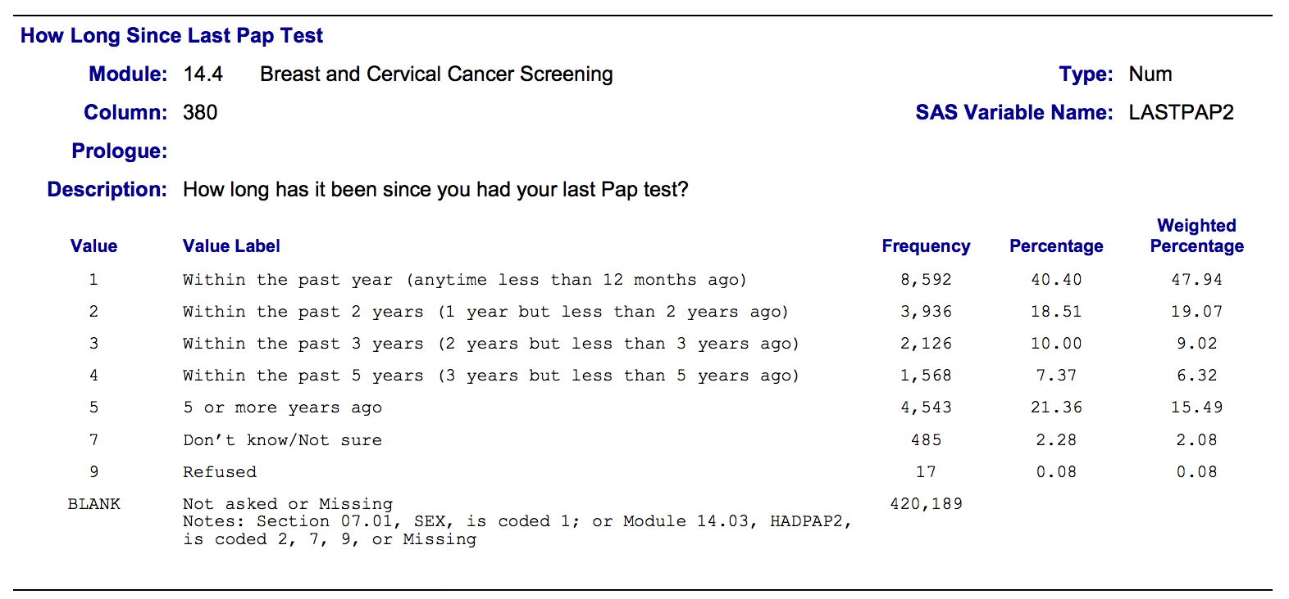
Notes:
For example, this is a section of the BRFSS codebook. This particular question is asking participants when they last had a pap test.

Slide 31
Notes:
Here you can see the possible answer choices.

Slide 32
Notes:
And, here you can see the number, and percentage, of participants who who gave the various answers.

Slide 33
Notes:
Finally, if you look towards the bottom of the screen you will see that 420,189 participants don’t have any value for this variable.

Slide 34
Notes:
And, you will also see some notes about why they are missing. It says that if their sex was 1, which is a male, or if their value for hadpap2 was 2, 7, 9, or missing, then they were never asked this question. This should immediately be setting off your skip pattern radar. Let’s quickly take a look at hadpap2.

Slide 35
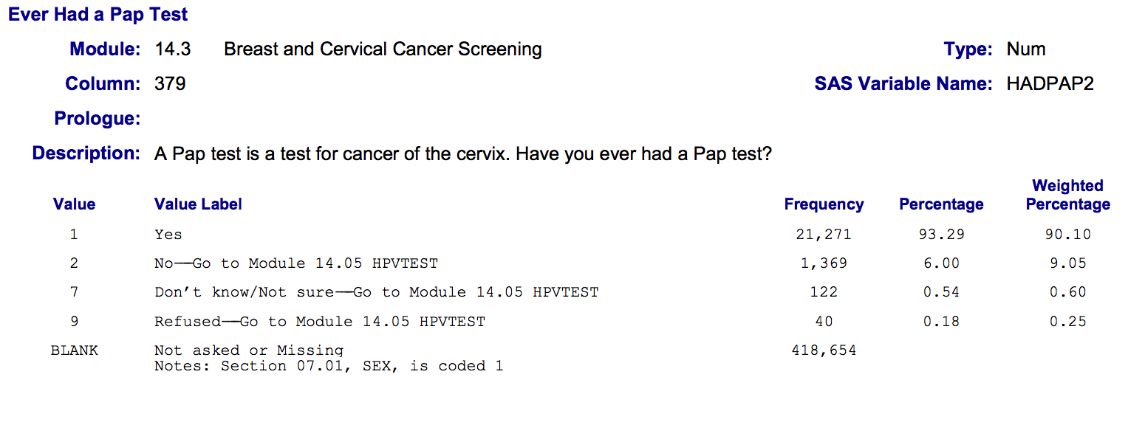
Notes:
Although it may not be immediately obvious because you can’t see the entire codebook here, if the participant says ”no”, “don’t know / not sure”, or refuses to answer this question, the instructions tell the person administering the survey to skip the rest of the questions in this module, which includes the question about last pap, and go directly to module 14.05.
So, it may not always be formatted this way, but every good codebook should alert you to any skip patterns that were used in the survey.

Slide 36
How do you know if there are skip patterns?
Codebook
Lots of missing data - sometimes
Notes:
Another indicator can be lots of missing data. It’s possible that the data is legitimately missing, and there is no contextual information available. However, I often find that when a high proportion of data is missing – especially on the big national surveys – it’s often because of a skip pattern.

Slide 37
Notes:
And remember, that’s exactly what we saw in the BRFSS example. 420,189 participants out of a possible 441,456 participants, or 95%, had a missing value for this question.

